Slide 1
Sentiment Analysis using Python
Group 11
Group Members:
Apurva Tawde
Himani Garg
Neha Khanna
Parika Gupta
Sisi fu
Vandana Agrawal

Slide 2
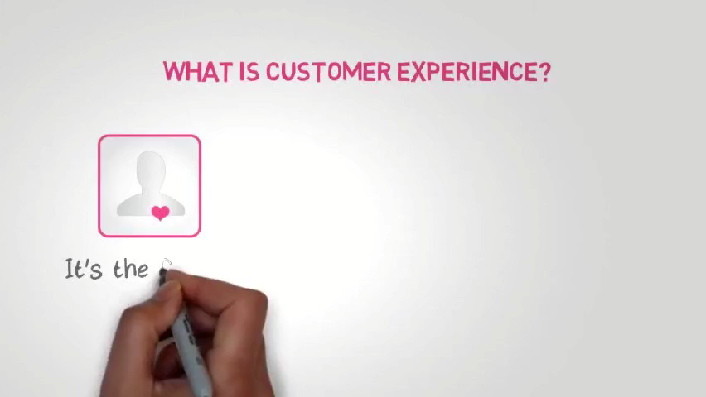

Slide 3
Motivation For Study:
55%
84%
70%
Consumers are willing to pay more for a Guaranteed Good Service
Organizations are embracing the Customer Experience Model
Companies use Customer Feedback to deliver best Customer Experience
Customer Experience
Advertisement

Slide 4
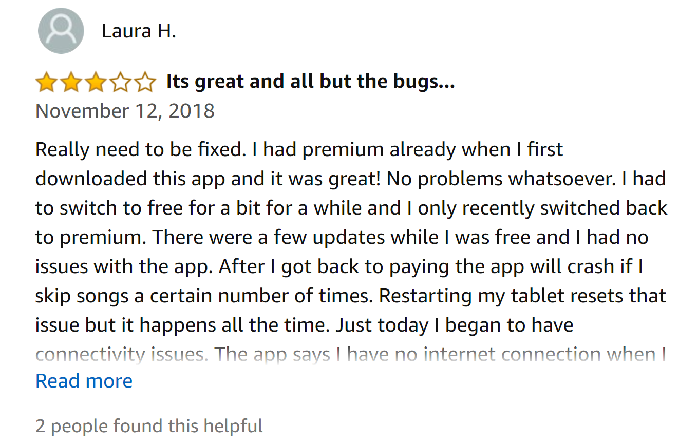
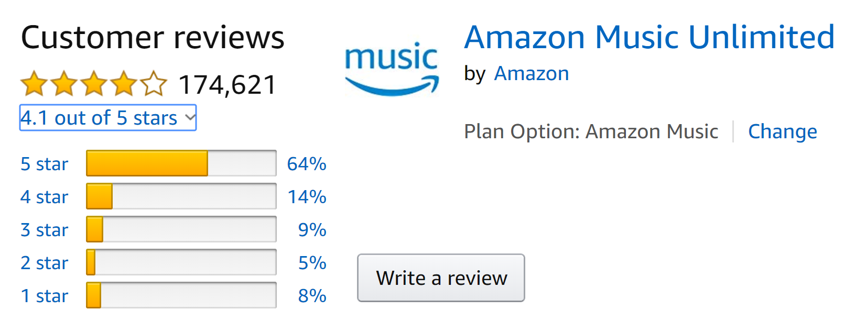
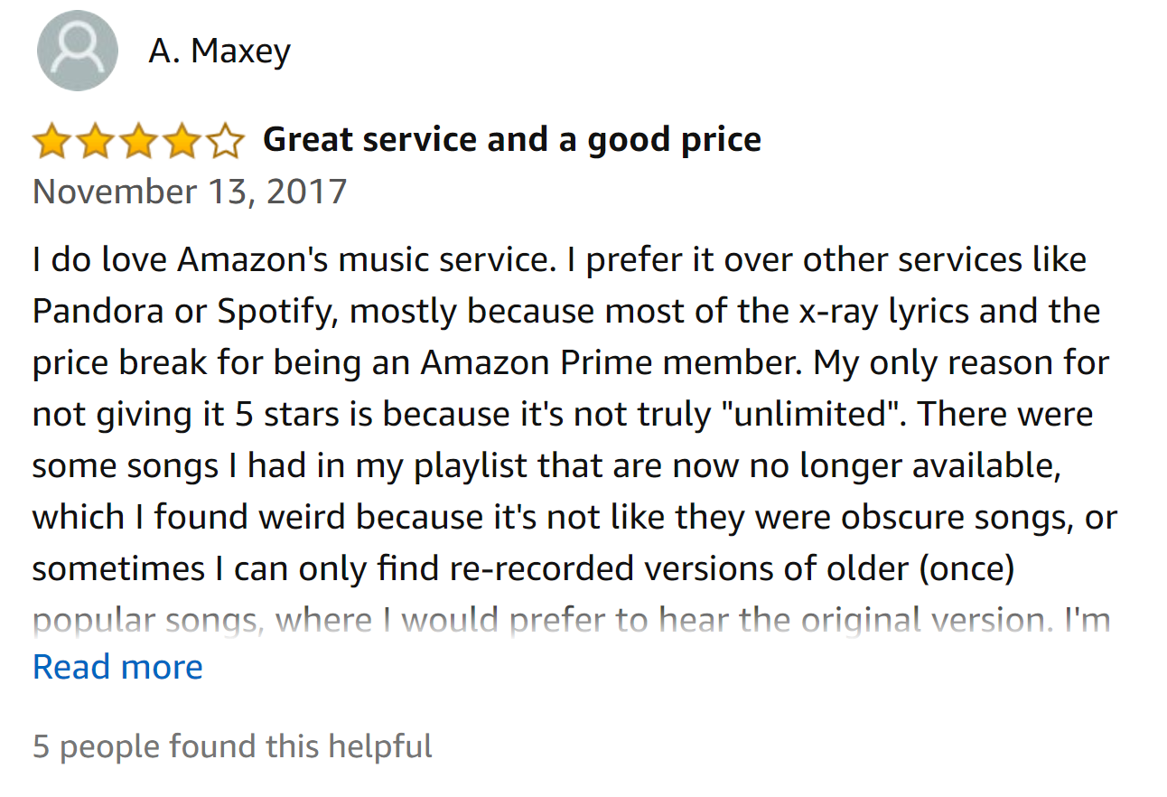




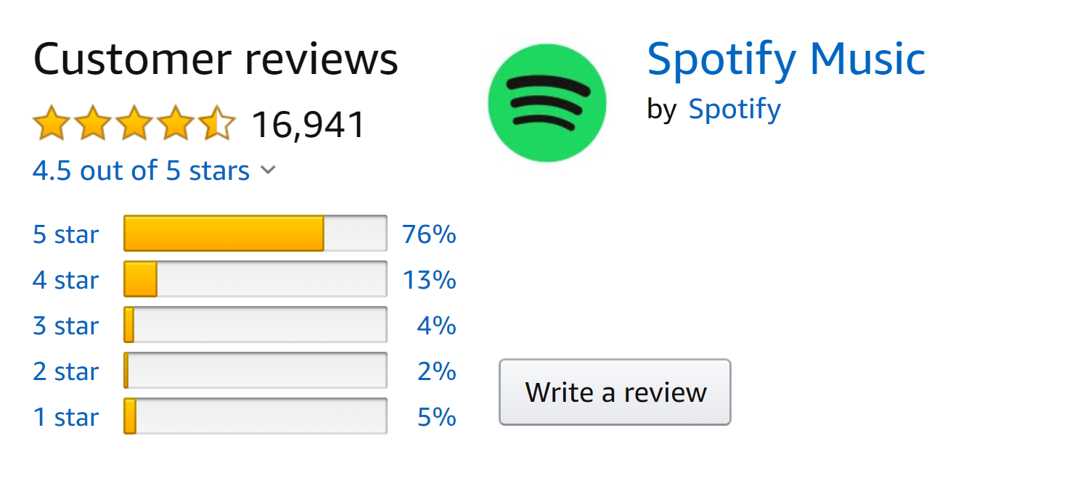
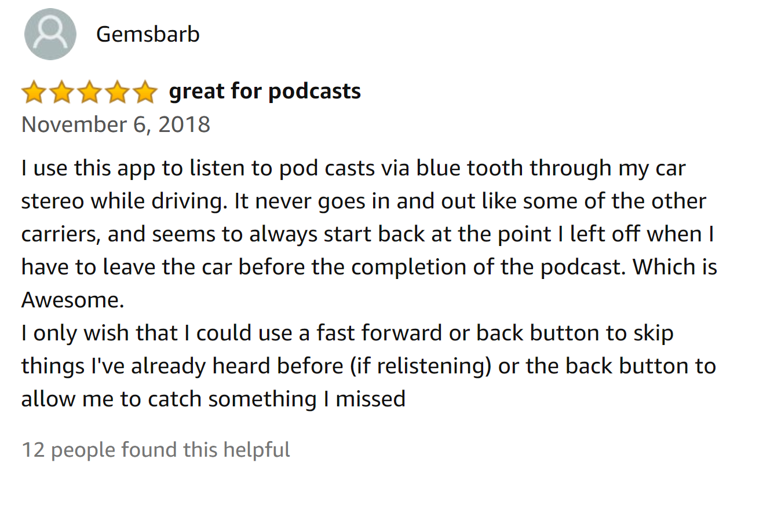
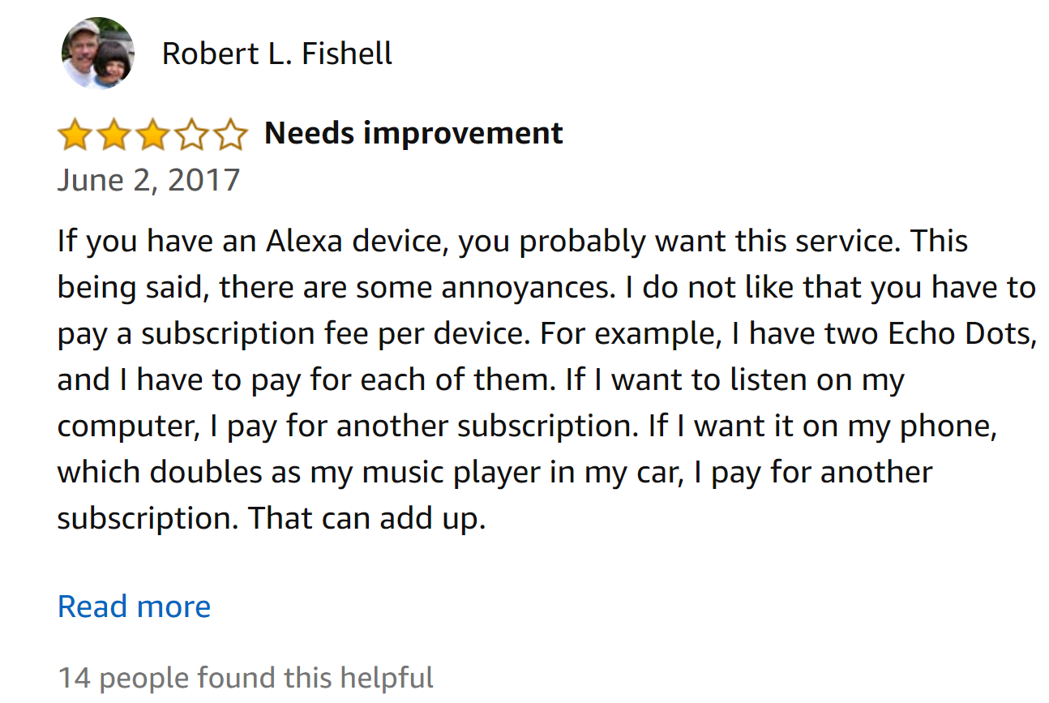
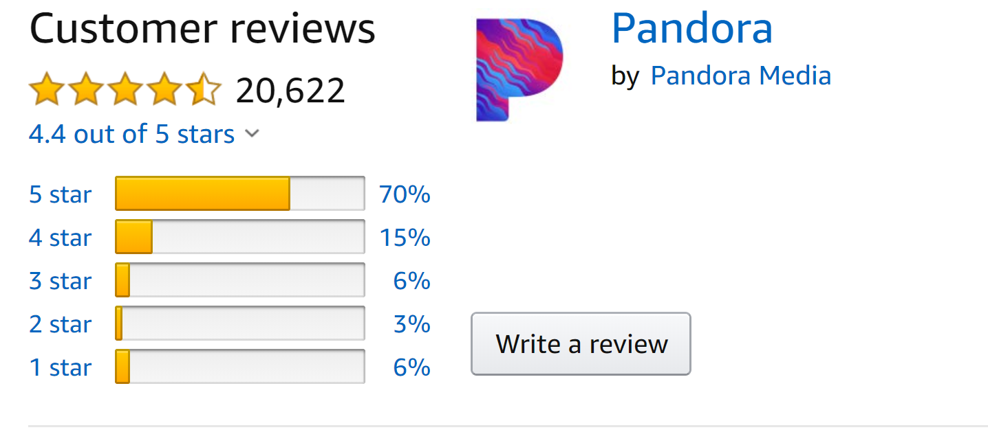
Voice Of Customer
Are Business Values Inline With Voice Of Customer?
We analyzed based on the customer reviews of three music streaming apps

Slide 5
Model: Our Approach
Data Cleaning
Aspect Based Analysis
Results
Sentiment Analysis

Slide 6
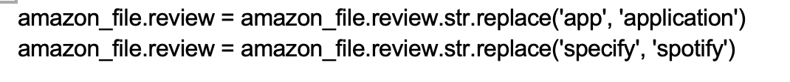
Unique Features in Code
Replace words
Spelling Correction

Slide 7
Sentiment Analysis
Opinion Mining on text data along with Emoticon Analysis

Slide 8

“That’s interesting “

Slide 9
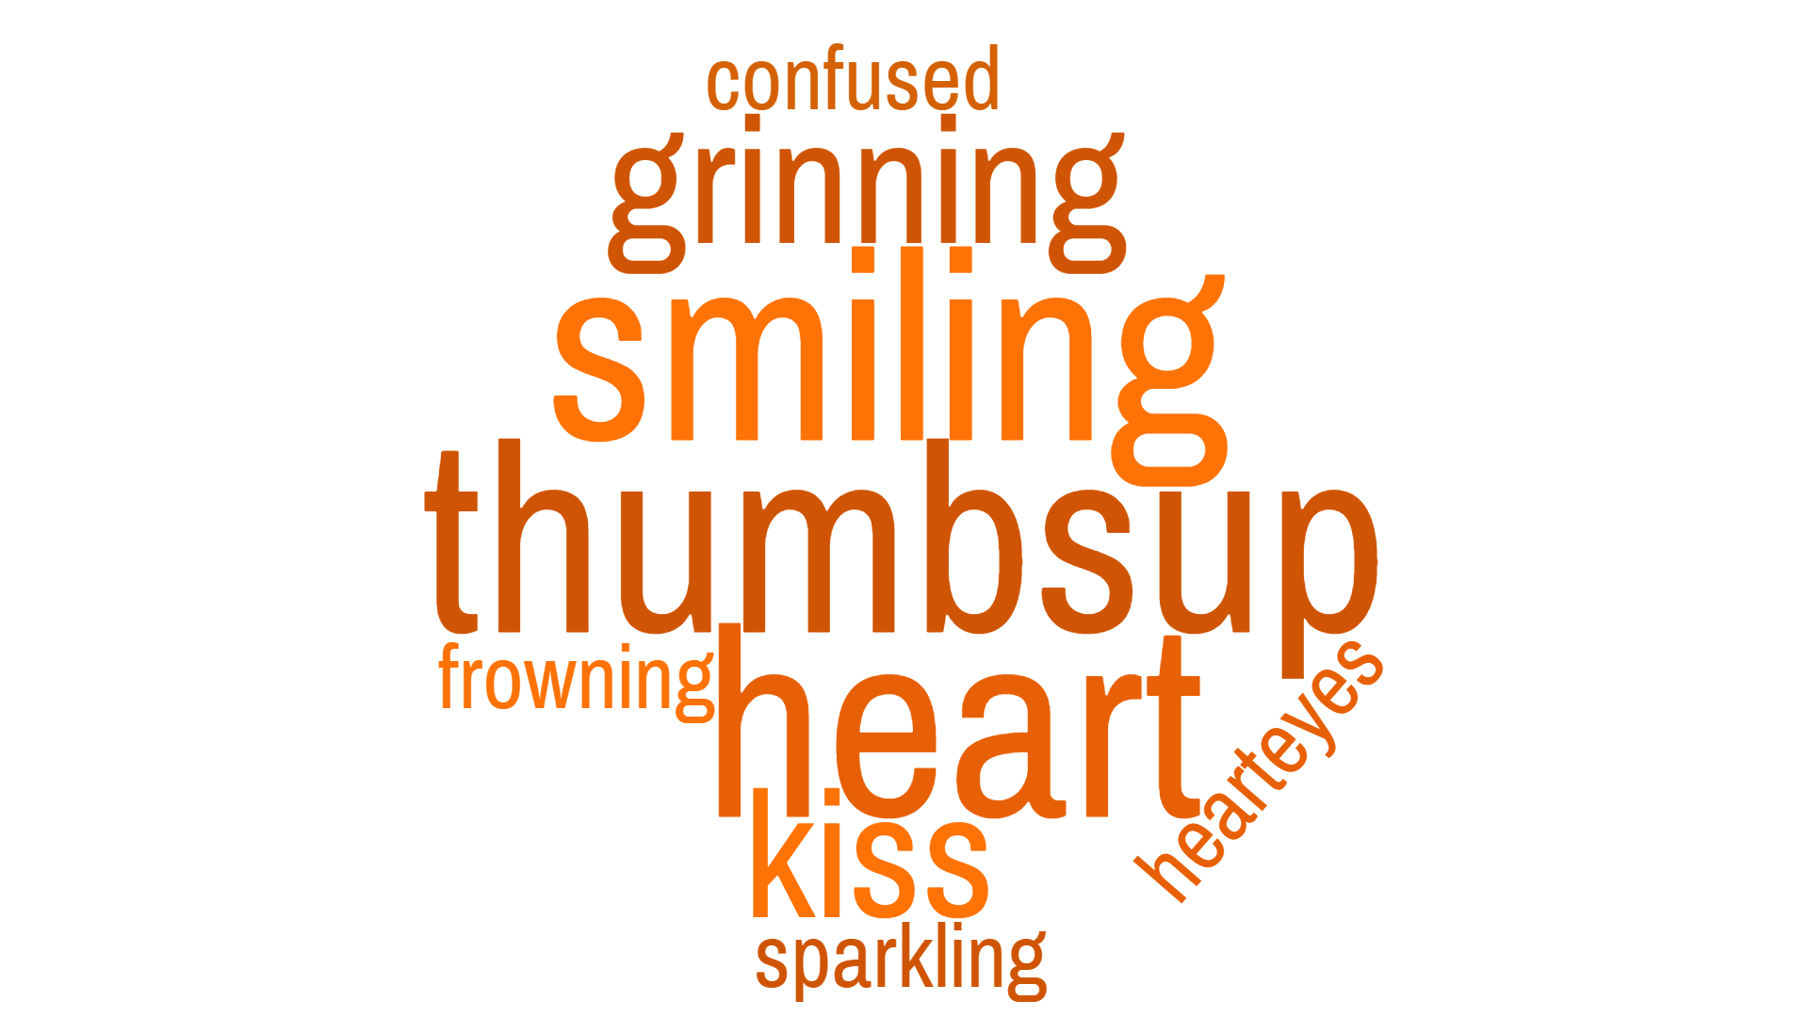

Emoticon Analysis

Slide 10
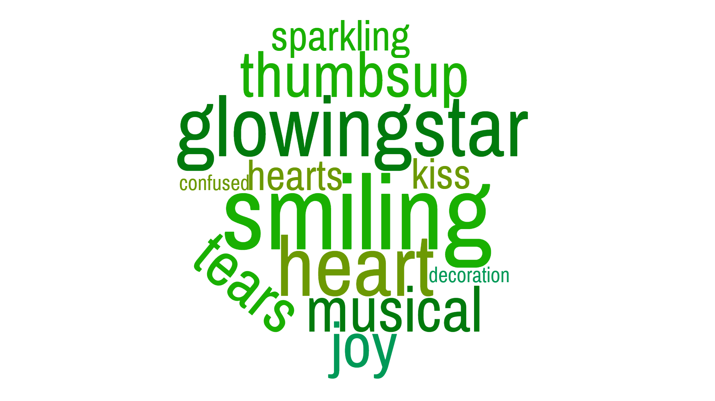
Emoticon Analysis

Slide 11
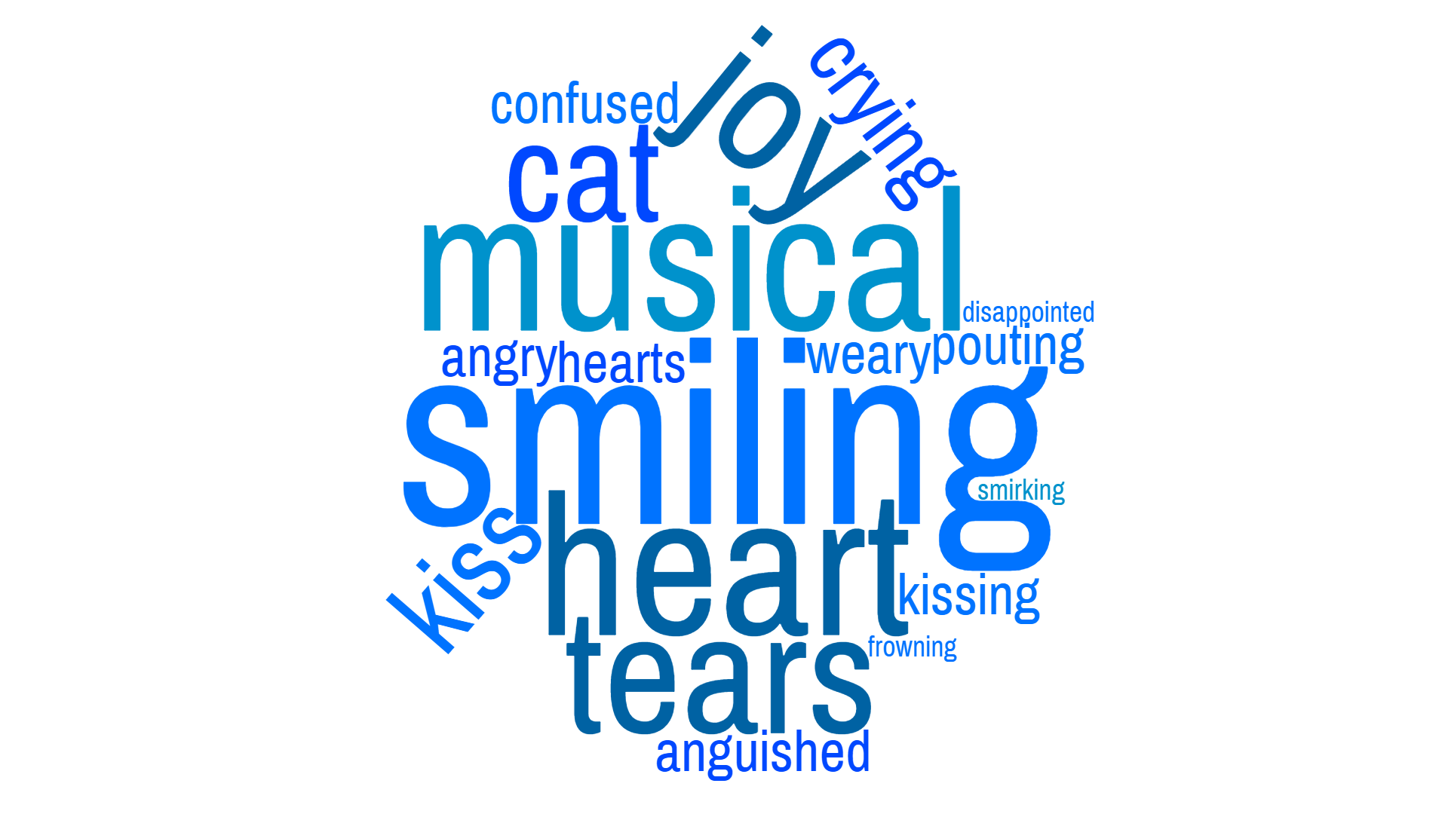
Emoticon Analysis

Slide 12
What is the 1st thing in your mind when you purchase Music streaming App?

Slide 13




Aspect Based Analysis
Cost
It is highly valuable to understand customers’ opinion in relation to four factors mentioned
Song
Collection
Stability
Of App
Advertisement

Slide 14
5.97%
3.4%
9.91%
6.27%
4.46%
8.85%
11.10%
44.76%
10.87%
38.48%
10.21%
41%
66.30%
69.99%
59.05%

Slide 15
Song Collection
SPOTIFY :“Music choices are great and diverse”
Notes:
-Add business model for each company to inline with out functionality

Slide 16
Cost
AMAZON :”Great app, lots of good tunes. So much available for free to prime members! Love the free music on my pc. “
PANDORA :” I do wish it had less commercials but I have it for free, so no real complaints“

Slide 17
Advertisement & Spam
PANDORA:”I only wish there weren't commercials, but I understand that to get this free you need them”
SPOTIFY:” The advertisements will always be the death of me!! But Spotify's gotta make money”
Notes:
-Add business model for each company to inline with out functionality

Slide 18


Slide 19
Application Stability
AMAZON :”Constantly crashes on my HTC m9. Had to disable app. Can't even uninstall.”

Slide 20
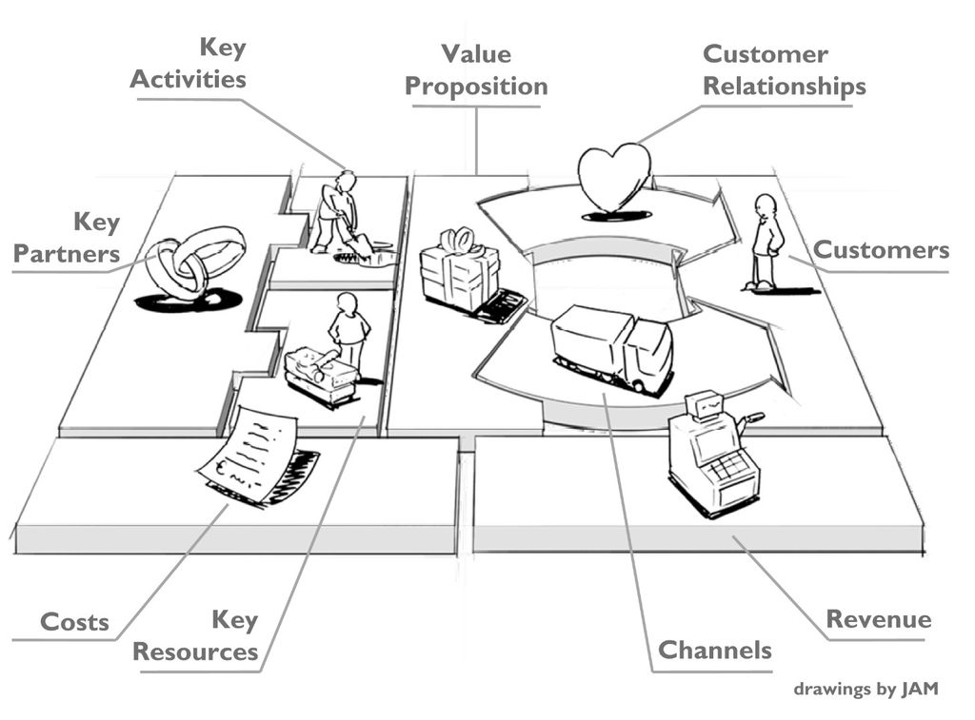
Business Model
Notes:
A business model is a company's plan for how it will generate revenues and make a profit. It explains what products or services the business plans to manufacture and market, and how it plans to do so, including what expenses it will incur
value proposition provides a unique combination of products and services which provide value to the customer by resulting in the solution of a problem the customer is facing or providing value to the customer. This is the point of intersection between the product you make and the reason behind the customer’s impulse to buy it.

Slide 21
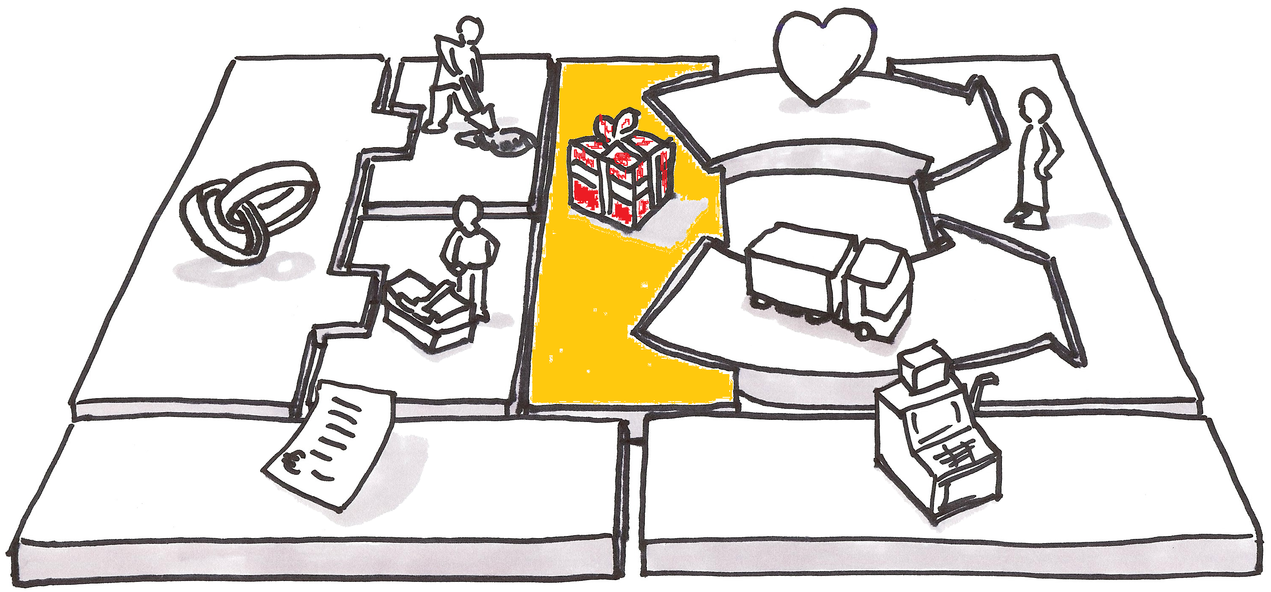
Value Proposition ?

Slide 22
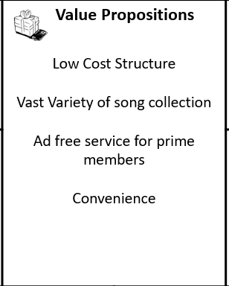
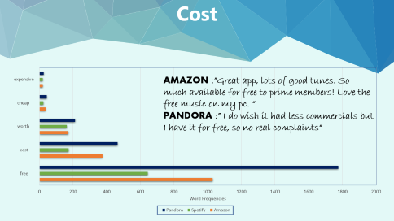
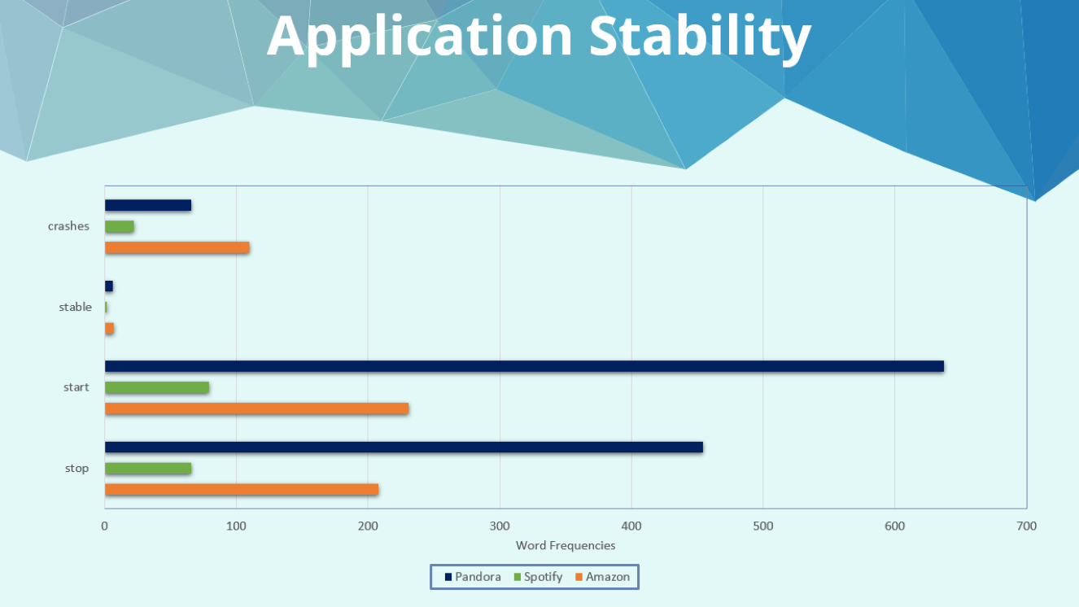

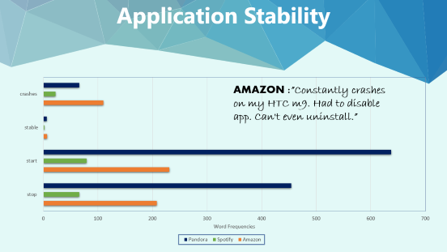
Amazon

Slide 23
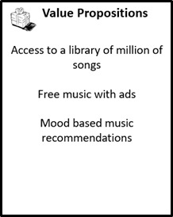
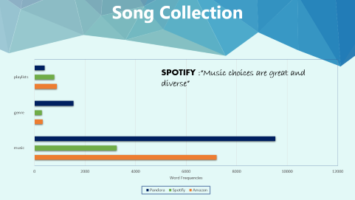
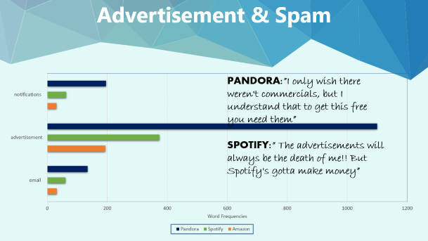
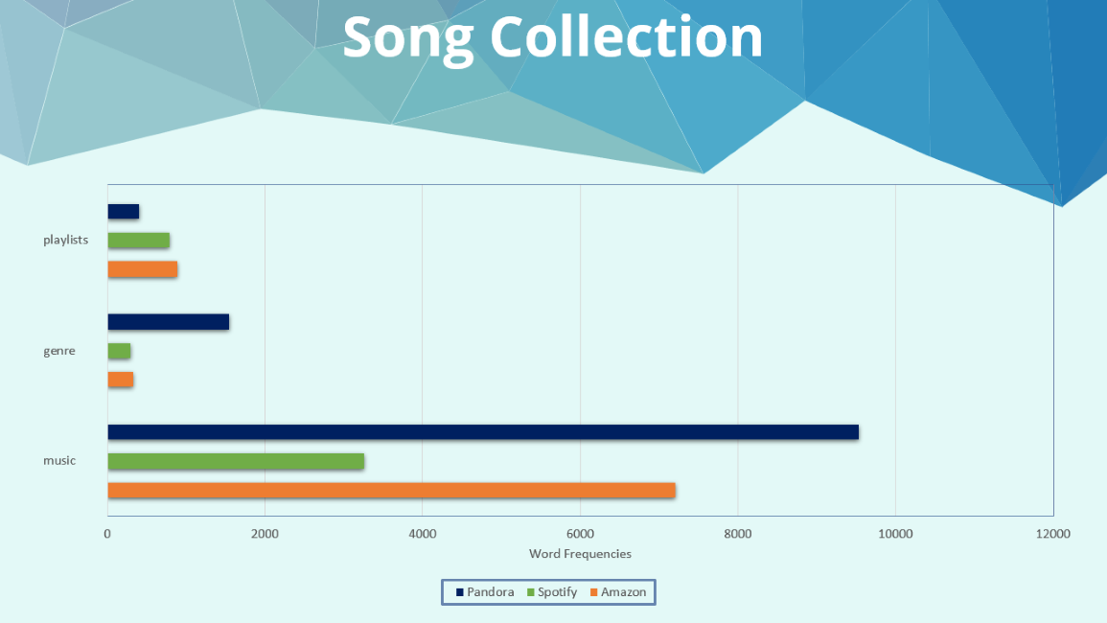
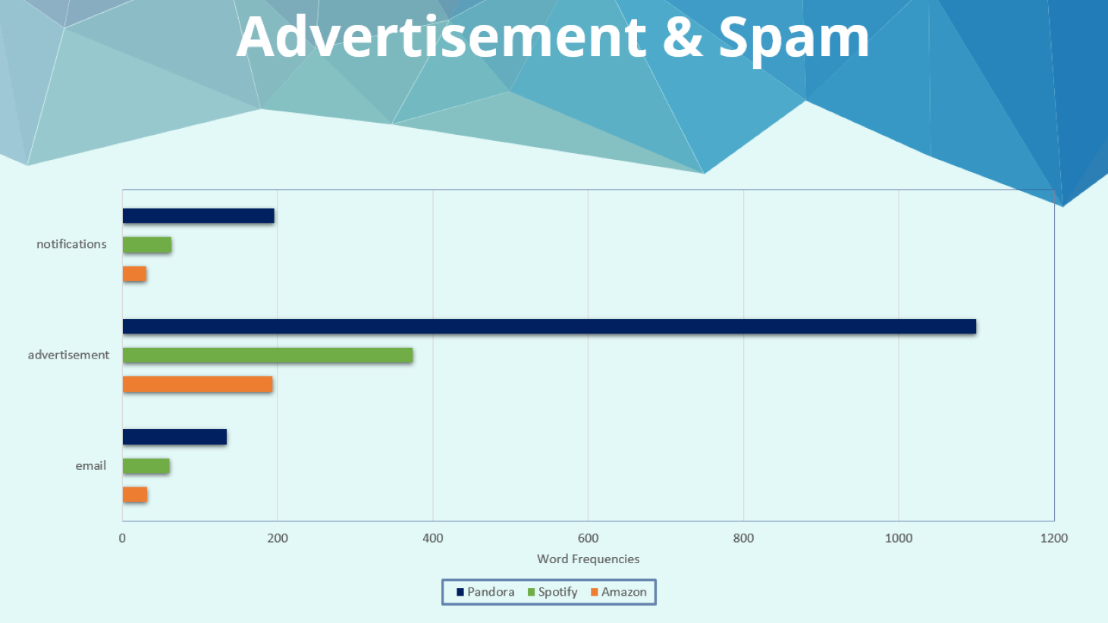
Spotify

Slide 24
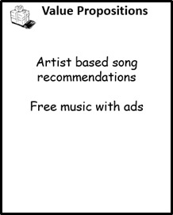


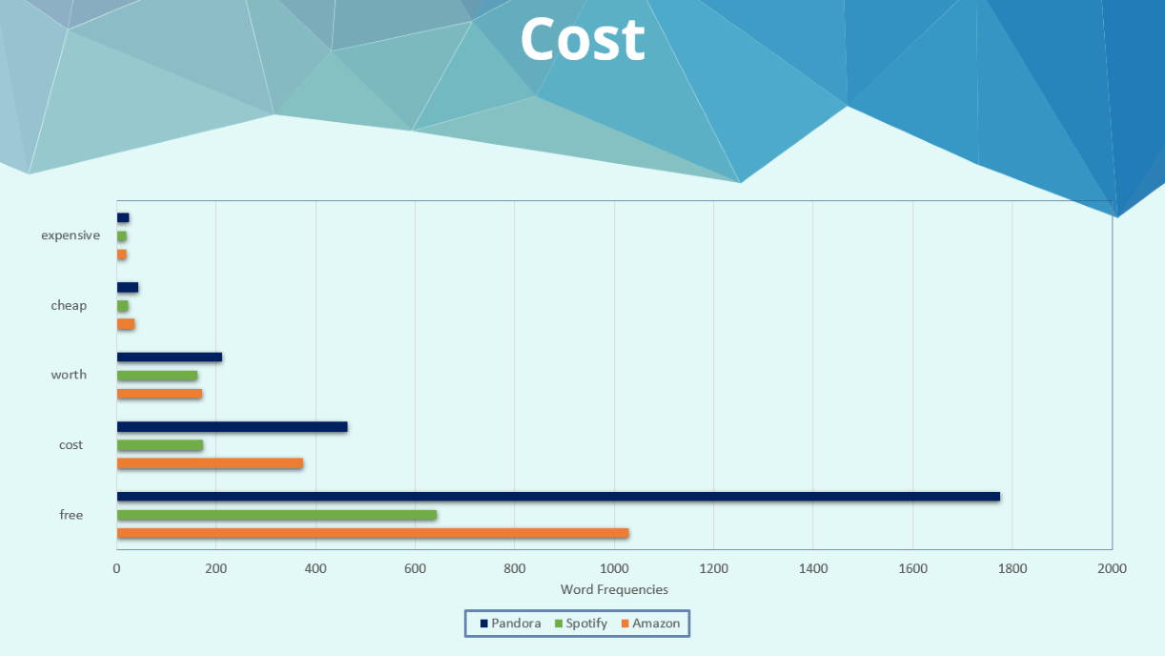

Pandora

Slide 25
Recommendations
Cost & Advertisement
No Ads
Low Cost
No Ads
Cost OK
Your Choice
Ads OK
Free Music

Slide 26
Recommendations
Music Catalog
Collection
Playlists

Slide 27
Sarcasm
And
Grammatical Errors
Sequences
Of
Words
Value Proposition
Improvements

Slide 28
Thank You!!!!!!
House is open for Q&A

Slide 29
Backup slides : Polarity Reports

Slide 30
Sentiment Analysis
1.Cover data to lowercase
2.Punctuation removal
3.Stop words removal
4.Number removal
5.Replace words
6.Lemmatization
7.Spelling correction
8.Get sentiment

Slide 31
Aspect Analysis
1.Create dictionary of words
2.Call the function defined below
3.Import packages from libraries
4.Define a function to count words where data frame and dictionary is passed as argument
5.Count the top 20 frequently occurring words
6.Exact emotions and meaning for emotions word cloud

Slide 32
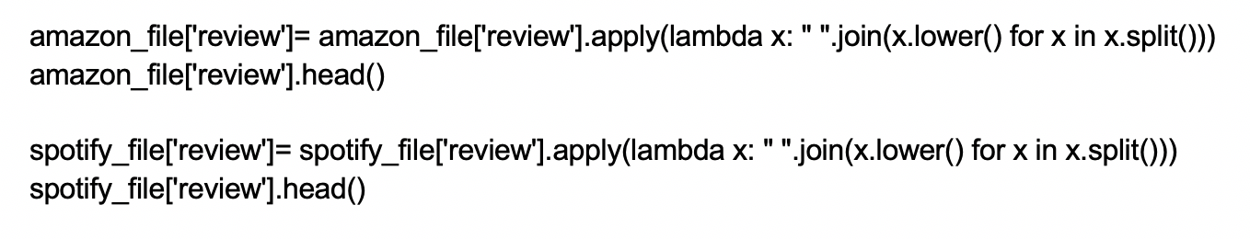
Convert data to lowercase

Slide 33
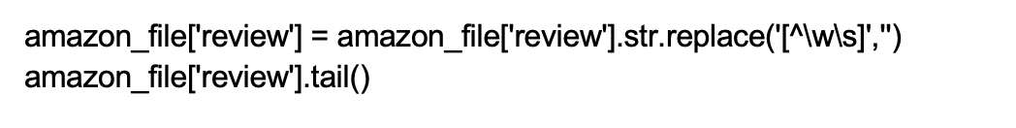
Punctuation Removal

Slide 34
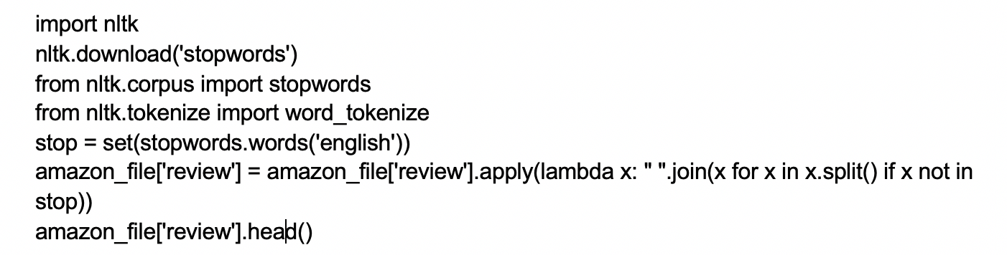
Stop words removal

Slide 35
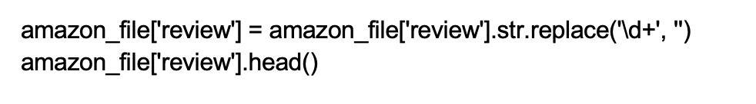
Number removal

Slide 36
Replace words

Slide 37
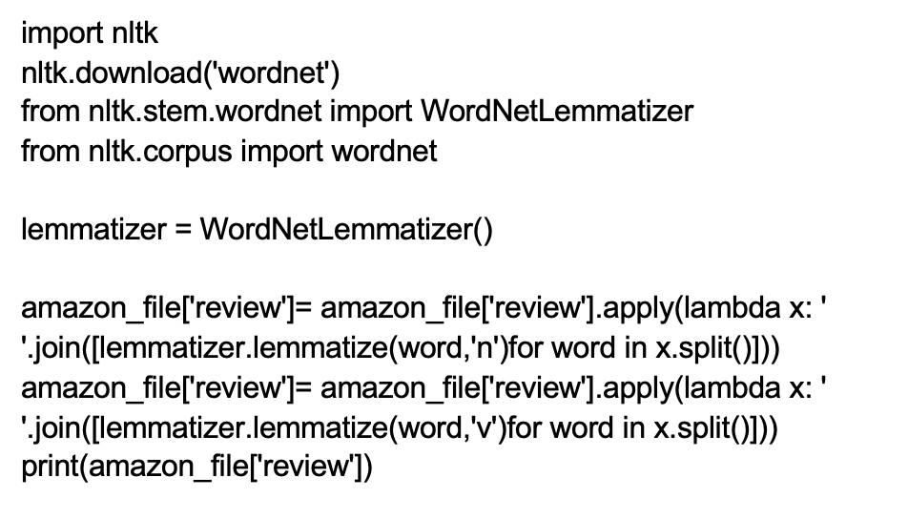
Lemmatization

Slide 38
Spelling correction

Slide 39
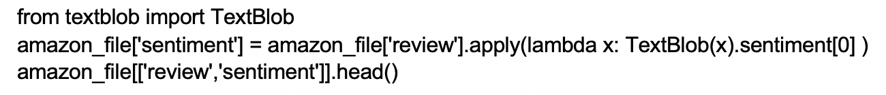
Get sentiment

Slide 40
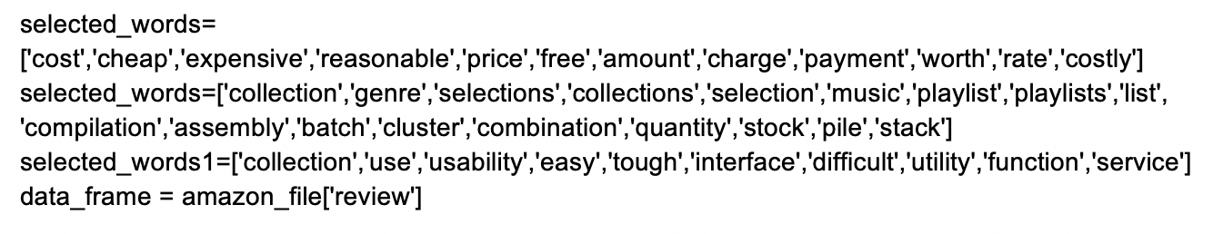
Create dictionary of words

Slide 41
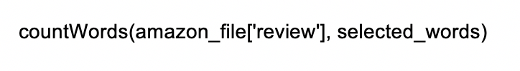
Call the function defined below

Slide 42
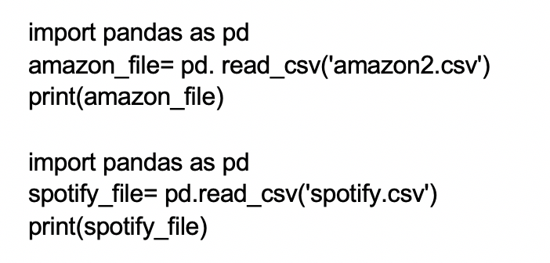
Import packages from libraries

Slide 43
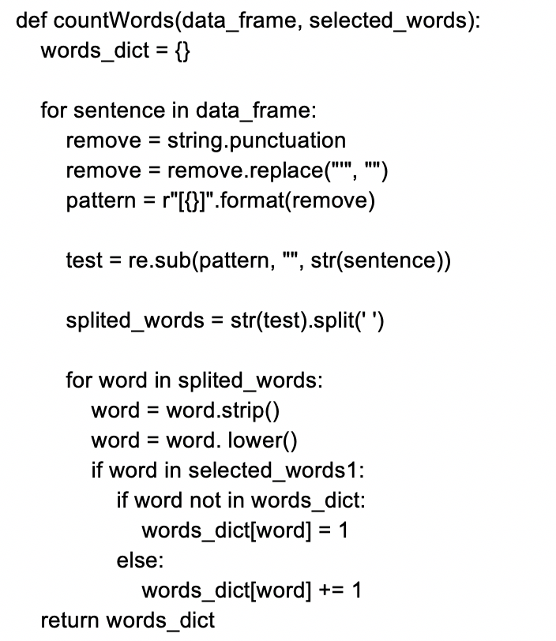
Define a function to count words where data frame and dictionary is passed as argument

Slide 44
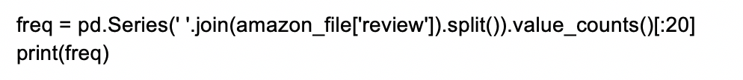
Count the top 20 frequently occurring words

Slide 45
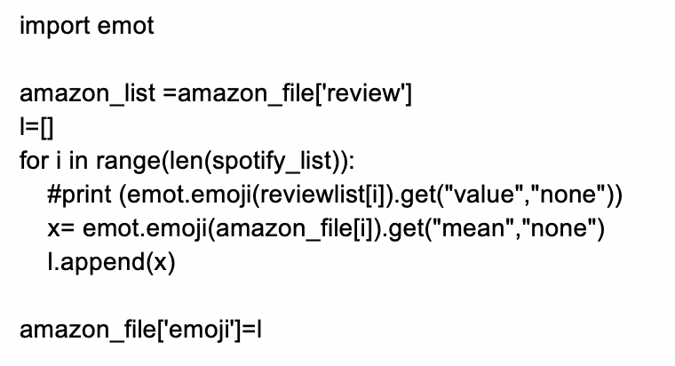
Extract emotions and meaning for emotions word cloud

